Slide 1
Plans and Predictions
“Be going to” FUTURE

Slide 2
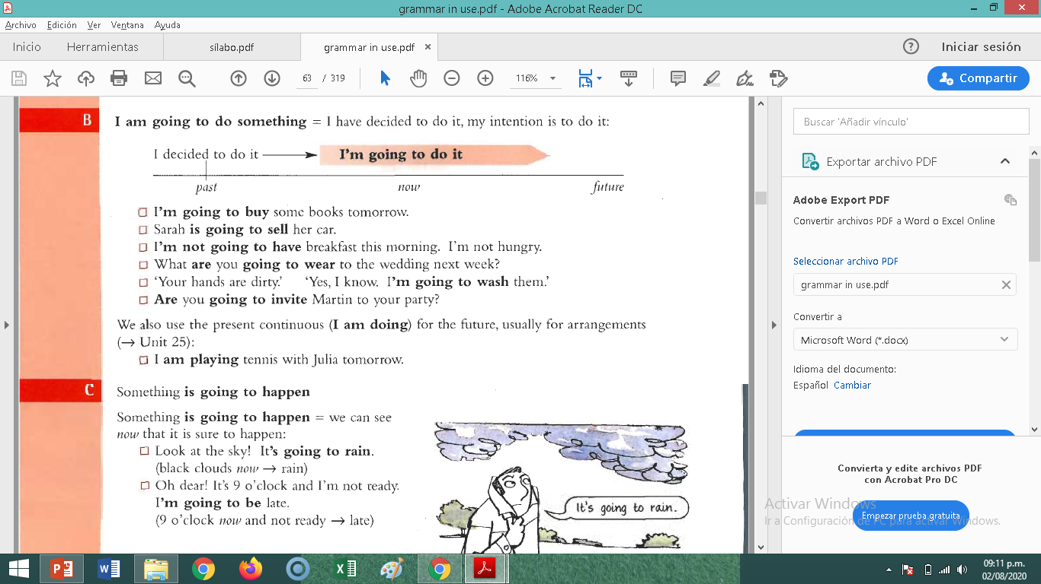
WE USE ‘BE GOING TO’:
FOR INTENTIONS AND DECISIONS

Slide 3
FOR PREDICTIONS (with evidence)

Slide 4
I am He is She is It is you are We are They are going to watch TV.
Affirmative Form

Slide 5

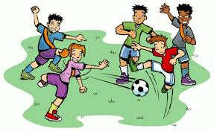

She is going to go shopping.
They are going to play football.
He is going to do homework.

Slide 6
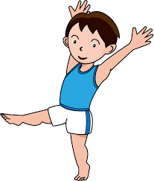
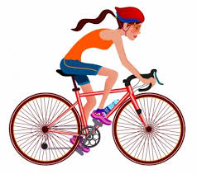
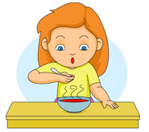
Make sentences with be going to.
Scott / do gymnastics
Scott's going to do gymnastics.
I / go cycling
I'm going to go cycling.
Kate / eat / some soup
Kate's going to eat some soup.

Slide 7
I am not He is not She is not It is not You are not We are not They are not going to watch TV.
Negative Form

Slide 8


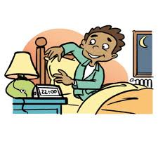
Make sentences with be going to.
I / not / surf the Internet
I'm not going to surf the Internet.
My dad / not / drink coffee
My dad isn't going to drink coffee.
Harry/ not /go to bed at 10 p.m.
Harry isn't going to go to bed at 10 p.m.

Slide 9
Am I Is he Is she Is it Are you Are we Are they going to watch TV?
Interrogative – Yes/No Questions

Slide 10
Interrogative – Information Questions
(WH-)
When
am I
is he
is she
is it
are you
are we
are they
going to
watch TV?

Slide 11
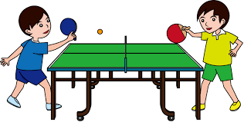
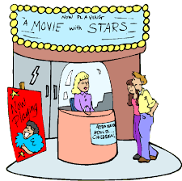
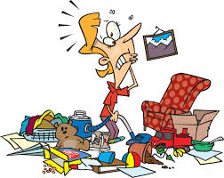
Make questions with be going to.
they / play / table tennis ?
Are they going to play table tennis?
Dave and Sue / go / to the cinema/ when?
When are Dave and Sue going to go to the cinema?
you / tidy up / today ?
Are you going to tidy up?

